Slide 1
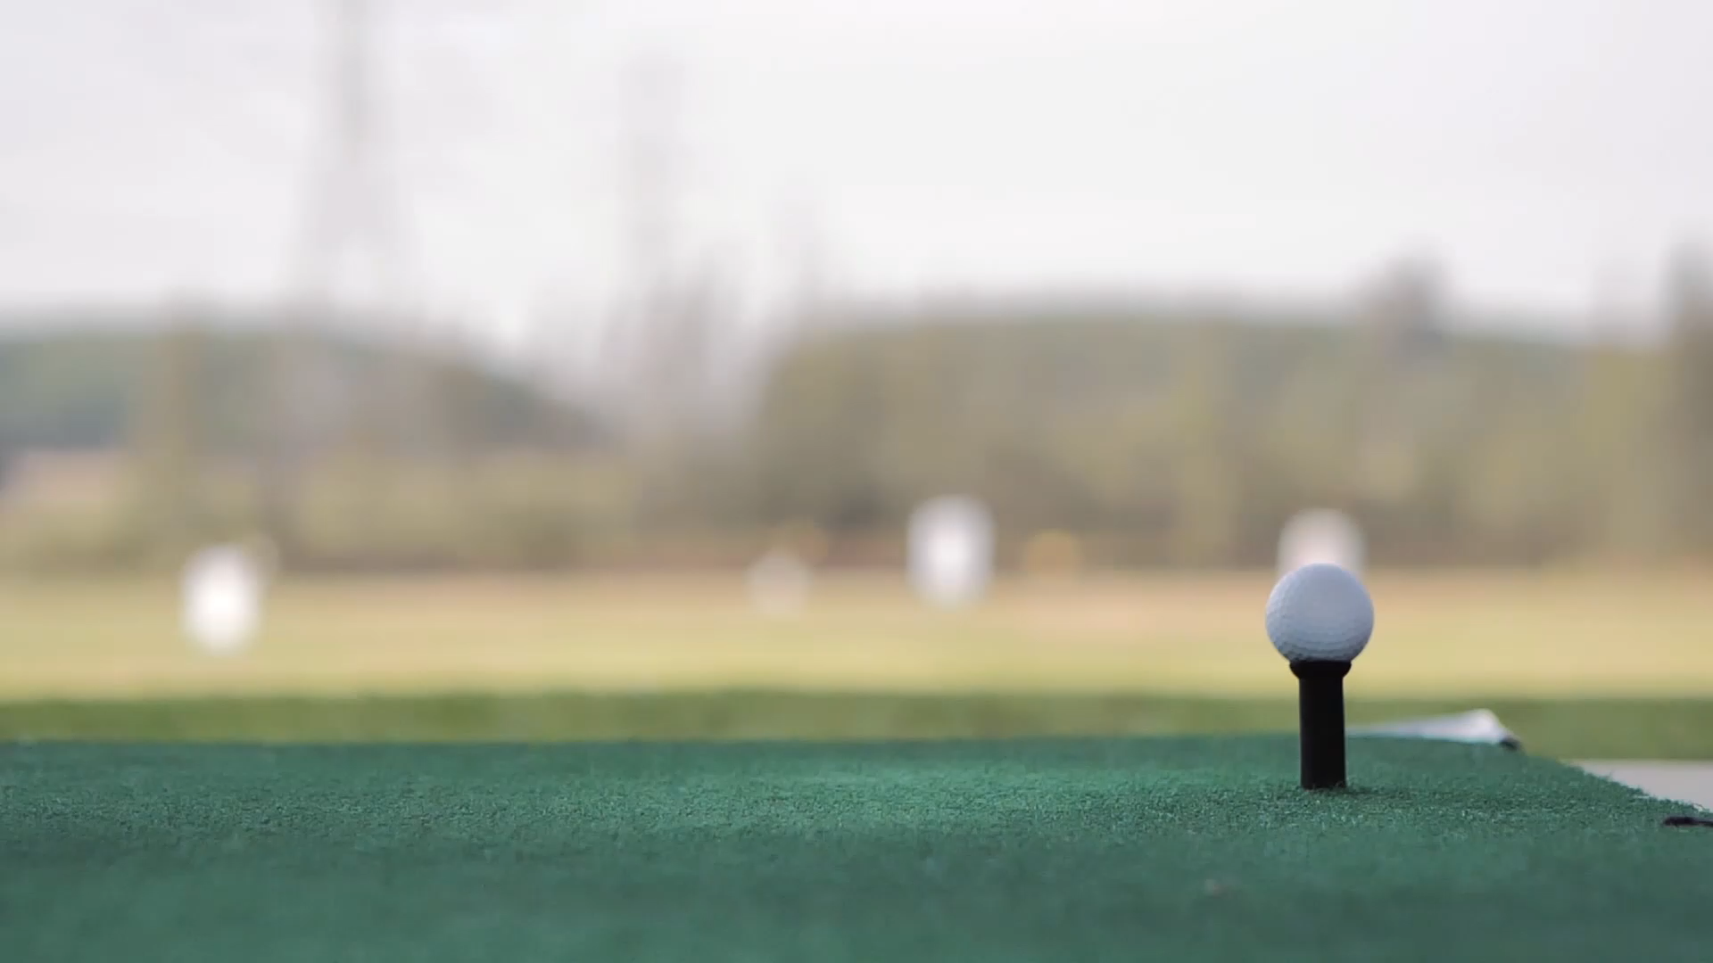
Custom Golf Ball Shop
Using React-Three-Fiber

Slide 2
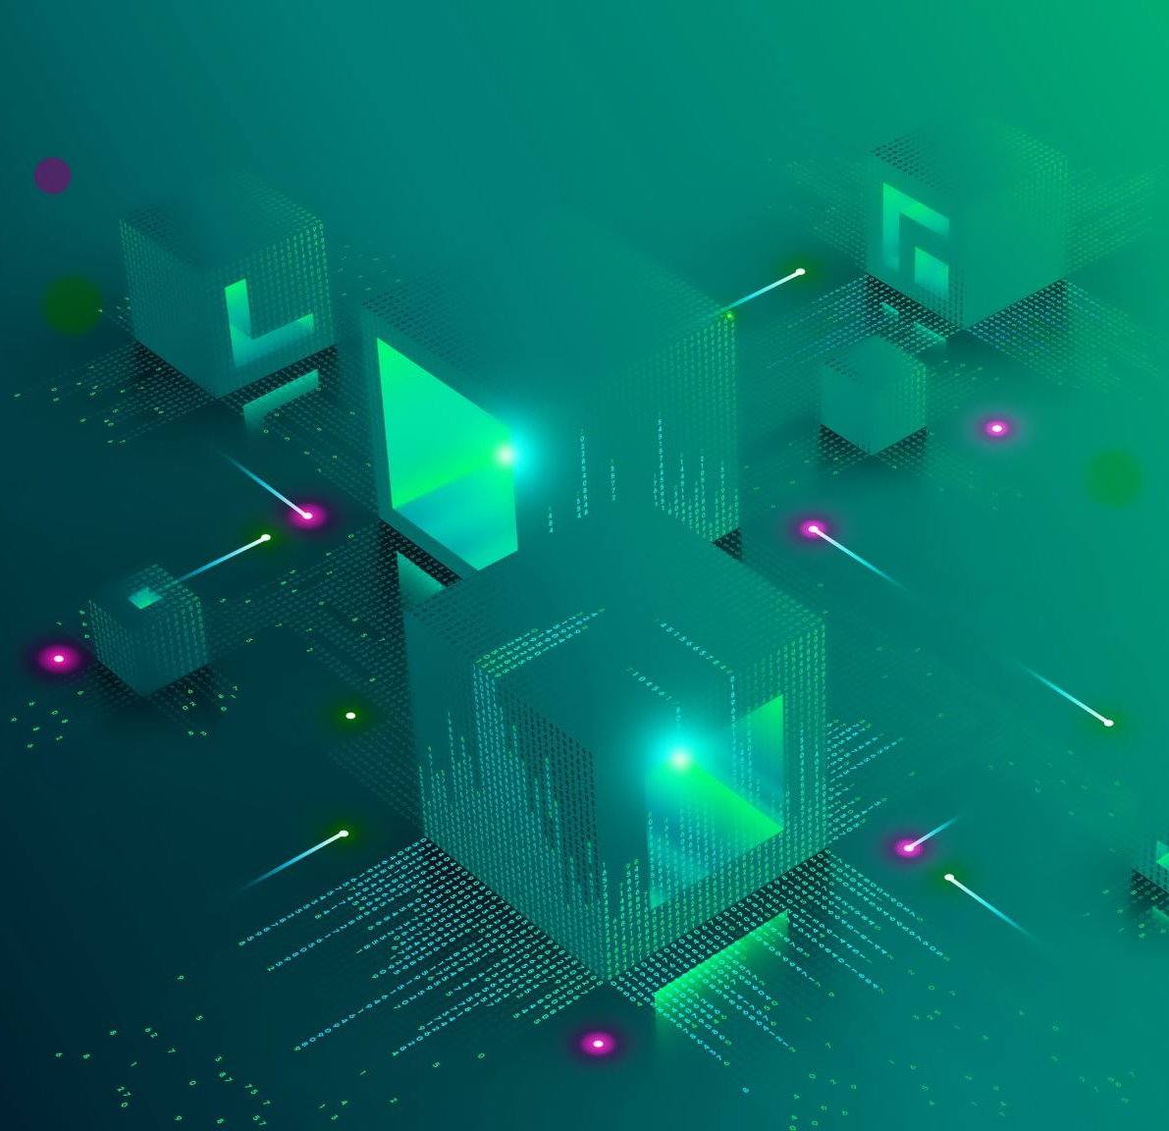
Background
WebGL allows websites to render 3D models
Takes advantage of graphics processors
Three.js is the first layer of abstraction, allowing developers to more effectively develop with 3D models
R3F is an additional abstraction, allowing us to use all the React technologies we are used to with 3D models
Huge ecosystem of technologies, very refined technology
No additional overhead, all Three.js functionality is available

Slide 3
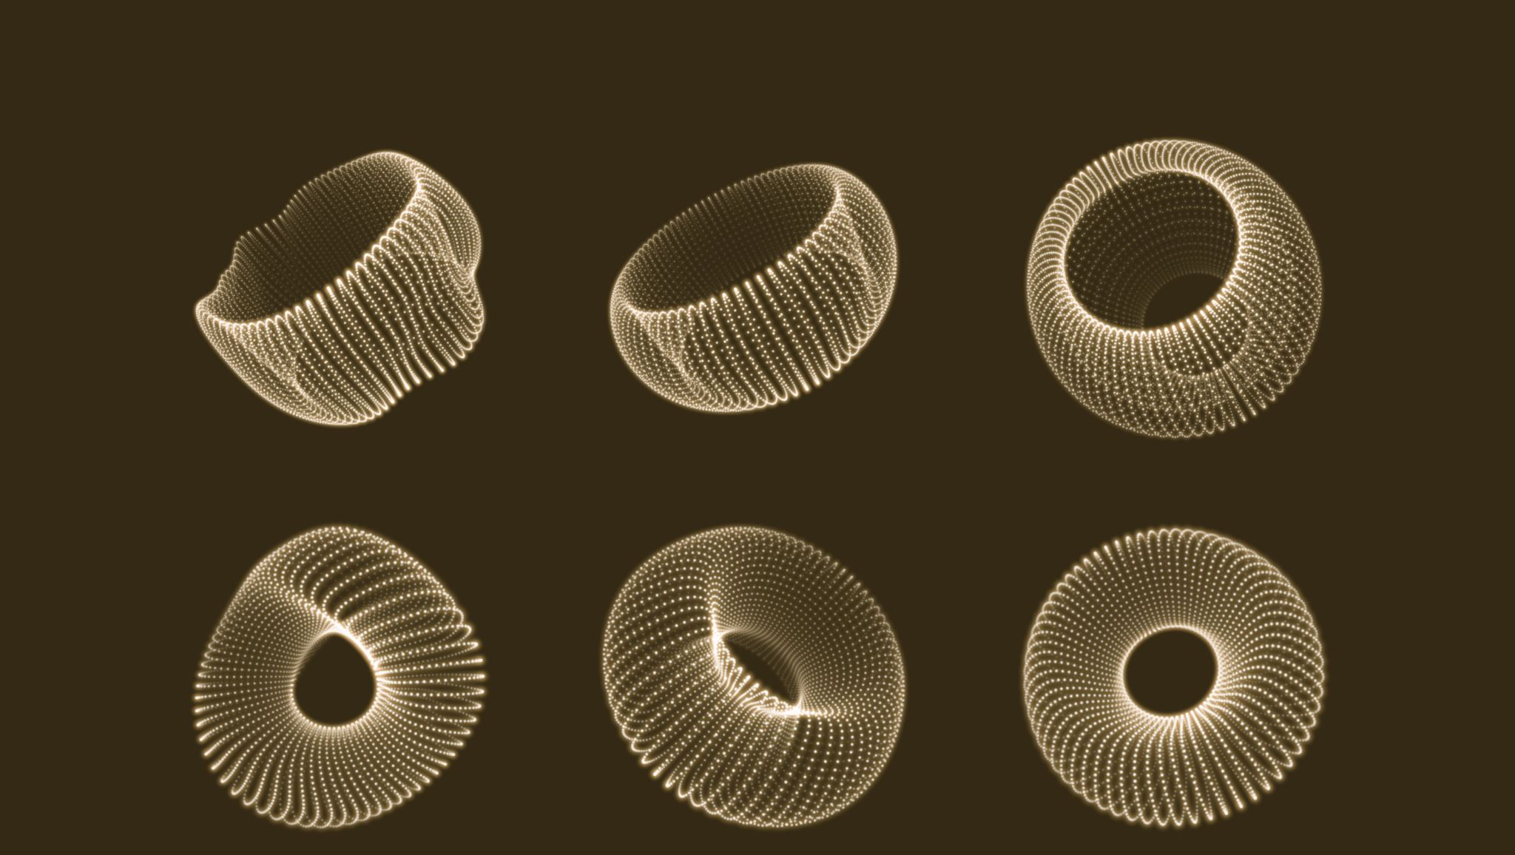
3D Models
Making your own 3D models is fine, but can be slow
Especially with more complex models
We decided to find free models on sketchfab
Finding free 3D models on sketchfab is great, but implementing by hand is pretty hard
Going through the GLB file, understanding the meshes, etc.
This led us to finding a website that does this part for you
R3F’s extensive community has created some great tools

Slide 4
GLTF → R3F
This website allows you to drag GLB files into and generates a working R3F component
Greatly reducing time spent integrating models
Allows us to repeatedly use the same model, as you’d expect from React Components
Can build off the generated model, allowing for customizability and unique functionality
Like adding certain qualities to the mesh
Color, images, etc.

Slide 5
Additional Technology
We used tailwindcss for styling
Inline, utility-based styling allowing us to make reusable styling components
Large ecosystem and learning available online
Used in industry
We used React-Router-DOM to make the website a Single Page Application
Speed up user interactivity
Quick implementation of routing
(anything else we used)

